Slide 1
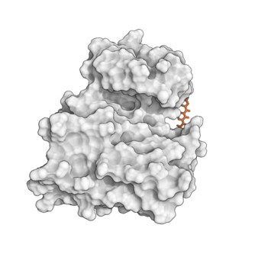
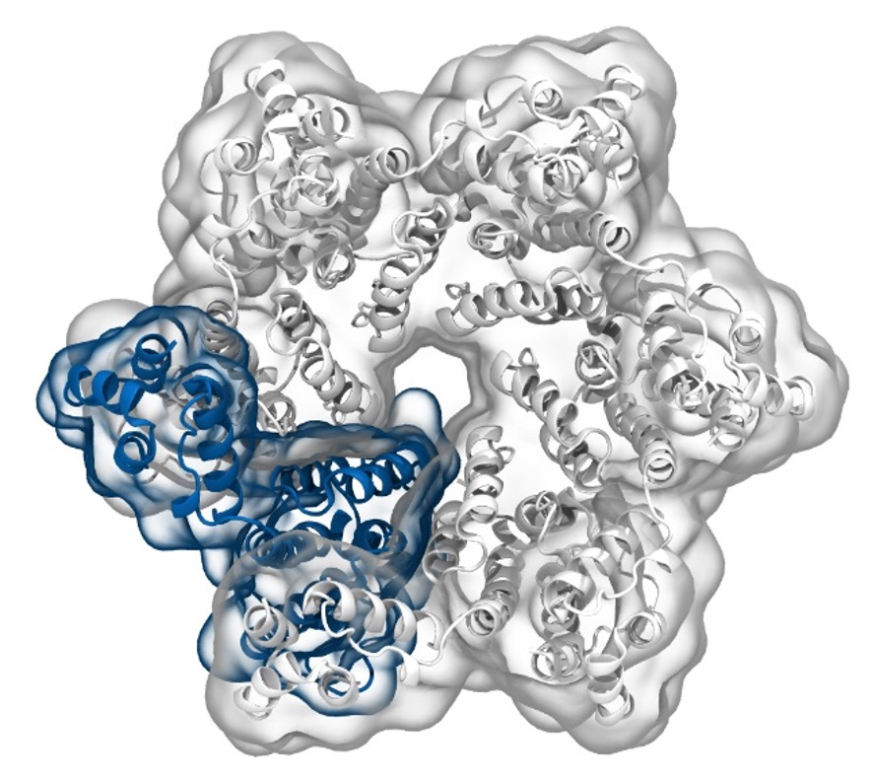
Simulation of Biomolecules
Simulation Analysis
part 1
2023 CCP5 Summer School
Dr Matteo Degiacomi
Durham University
matteo.t.degiacomi@durham.ac.uk
Dr Antonia Mey
University of Edinburgh
antonia.mey@ed.ac.uk

Slide 2


Slide 3
Large ecosystem of Python-based tools data analysis
And many more…
3

Slide 4
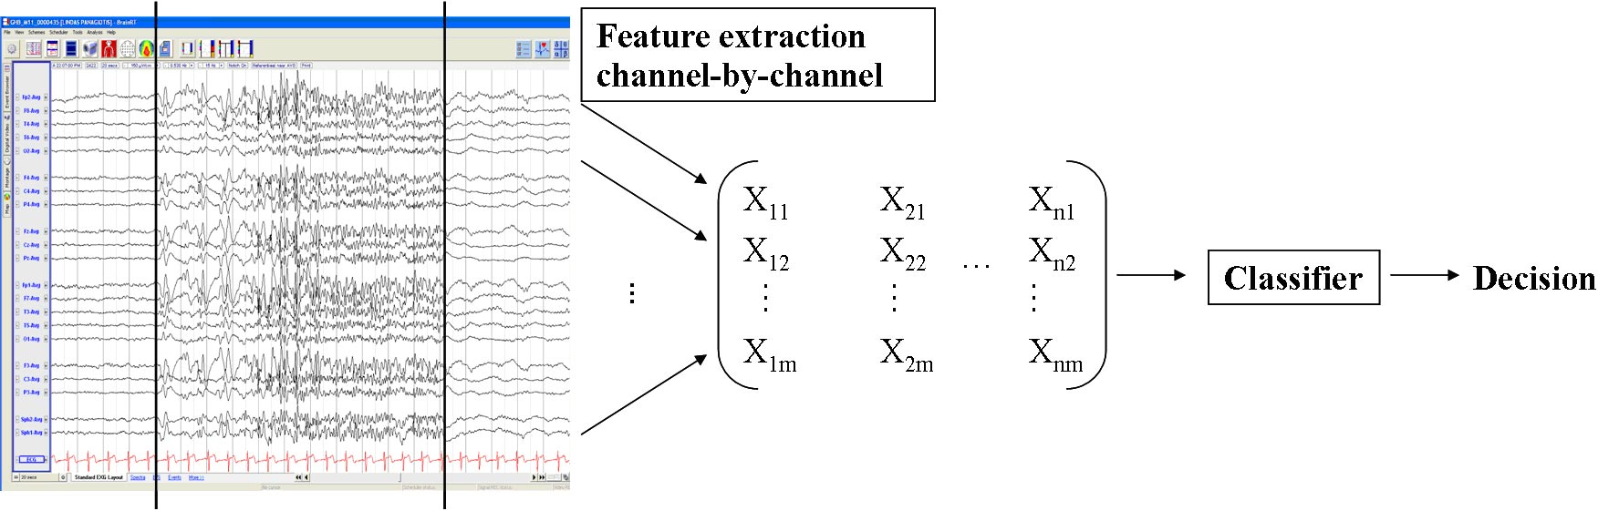
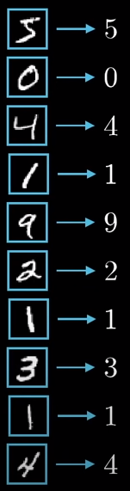
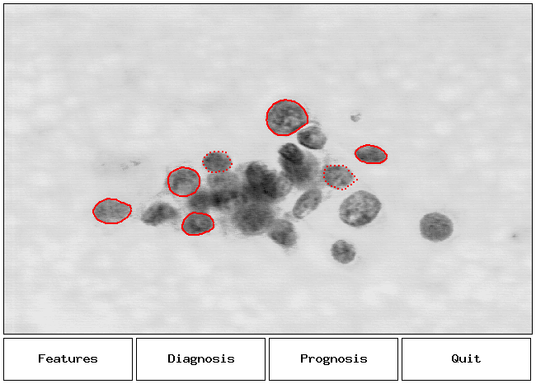
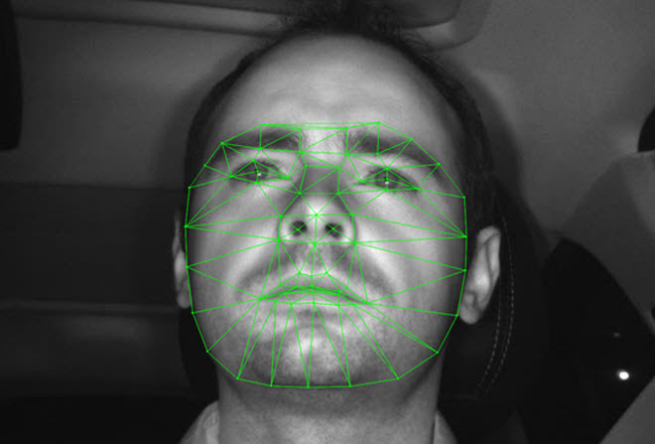
MD simulations produce complex, high-dimensional data
ACS Omega 2022, 7, 16, 14069–14073
4

Slide 5
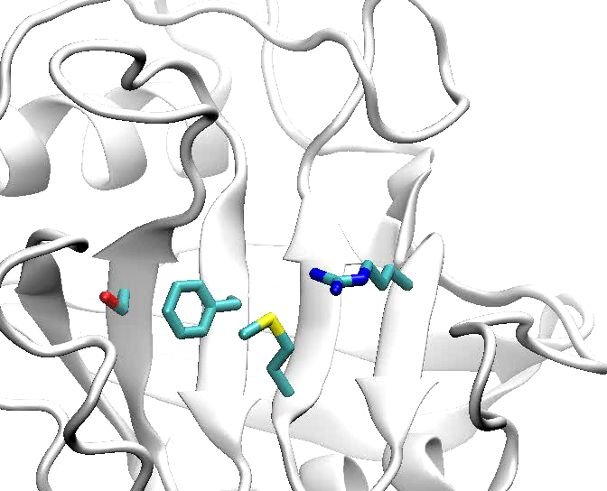
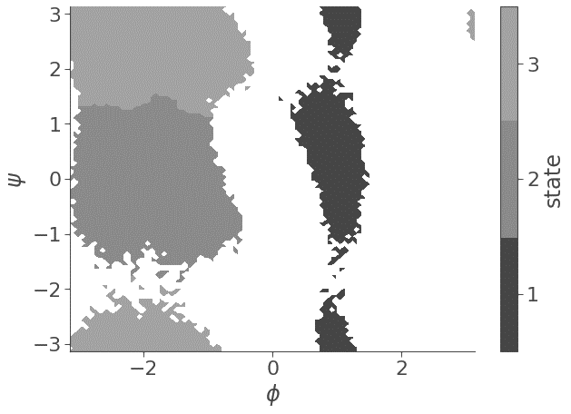
Features are possible ways to represent data
Pixels colour
Torsional angles
Interactomic distances
5

Slide 6

The Data Mining world
From scikit-learn.org
6

Slide 7
The Data Mining world
From scikit-learn.org
7

Slide 8
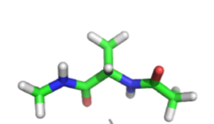
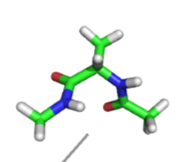
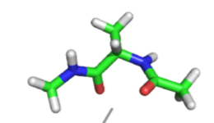
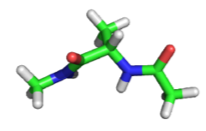
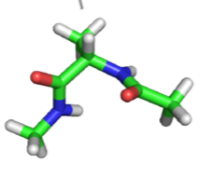
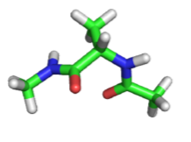
Dimensionality reduction for MD simulations
φ
ψ
ψ
Alanine dipeptide
φ
8

Slide 9
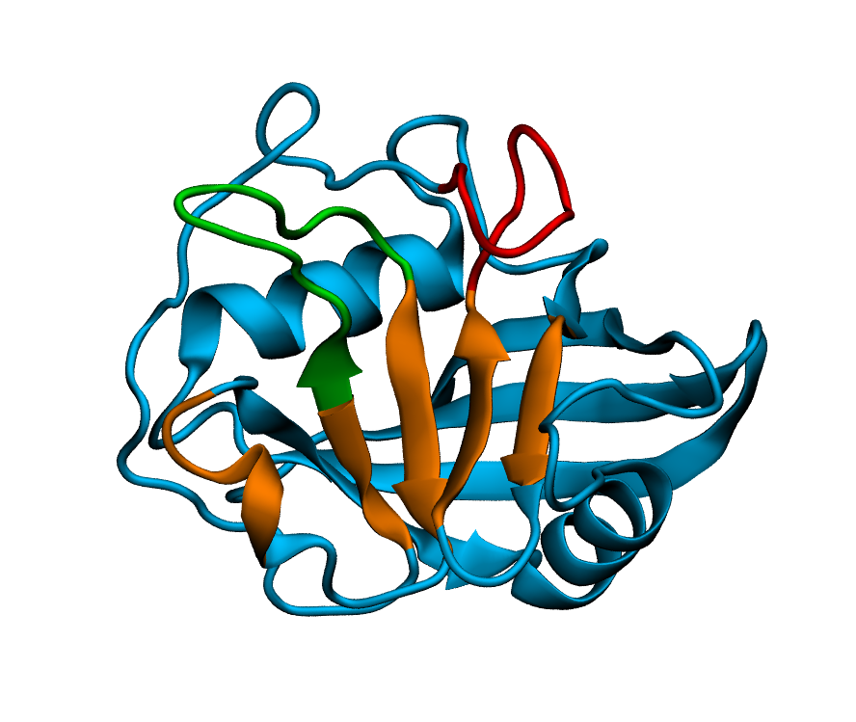
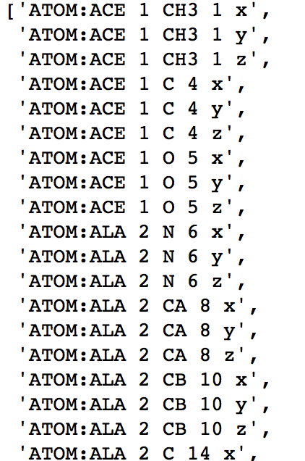
Dimensionality reduction for MD simulations
9

Slide 10
Dimensionality reduction — TICA, PCA, VAMP
Project features onto low dimensional subspace
PCA: Linear combination of input features maximising the variance
TICA: Linear combination of input features maximising time autocorrelation
VAMP: Variational approach for Markov Process, true for non-equilibrium data
VAMP: W. Chen et al., J. Chem. Phys., 2019
10

Slide 11
Principal Components Analysis (PCA)
Finds the reference system where each dimension maximises data variance.
“Data is mostly spread along the first dimension, then the second, …”
Lowest dimensions describe noise
First principal component does not align with line of best fit
11

Slide 12



PCA, formally
Let the covariance matrix of some data X
Let the generalised eigenvalue problem:
Gives an eigenvector matrix W that will allow the transform of the original data X onto a new basis T that maximises the variance.
It is possible to choose m eigenvectors to project onto by only using the first m-columns of W.
12

Slide 13
[Example 1] representing written digits
MNIST database of written digits
2 principal components manage to project a few of the digits in a similar area of space!
Input is a vector of 64 dimensions 8x8 pixel digits
13

Slide 14
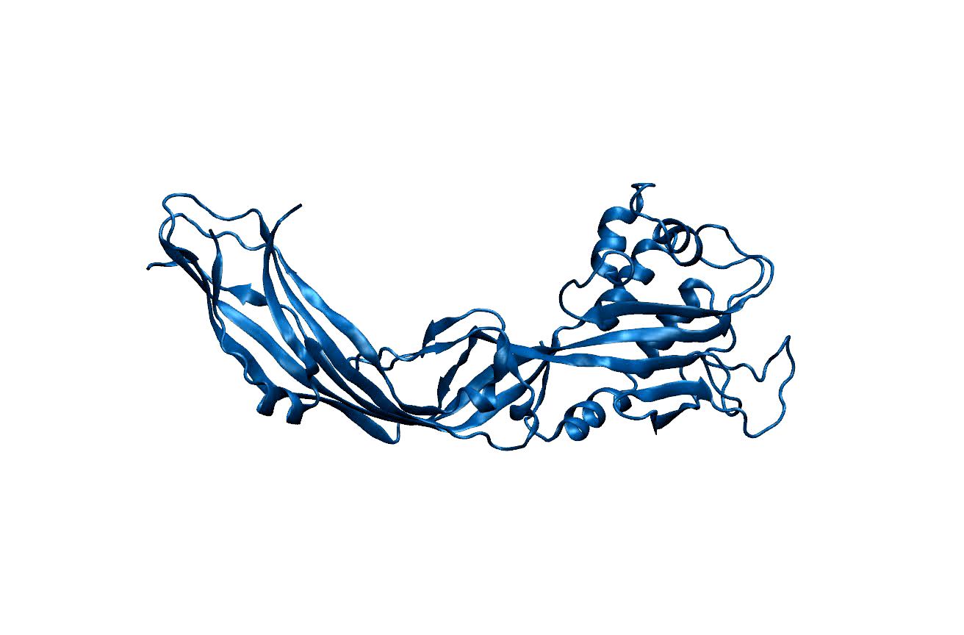
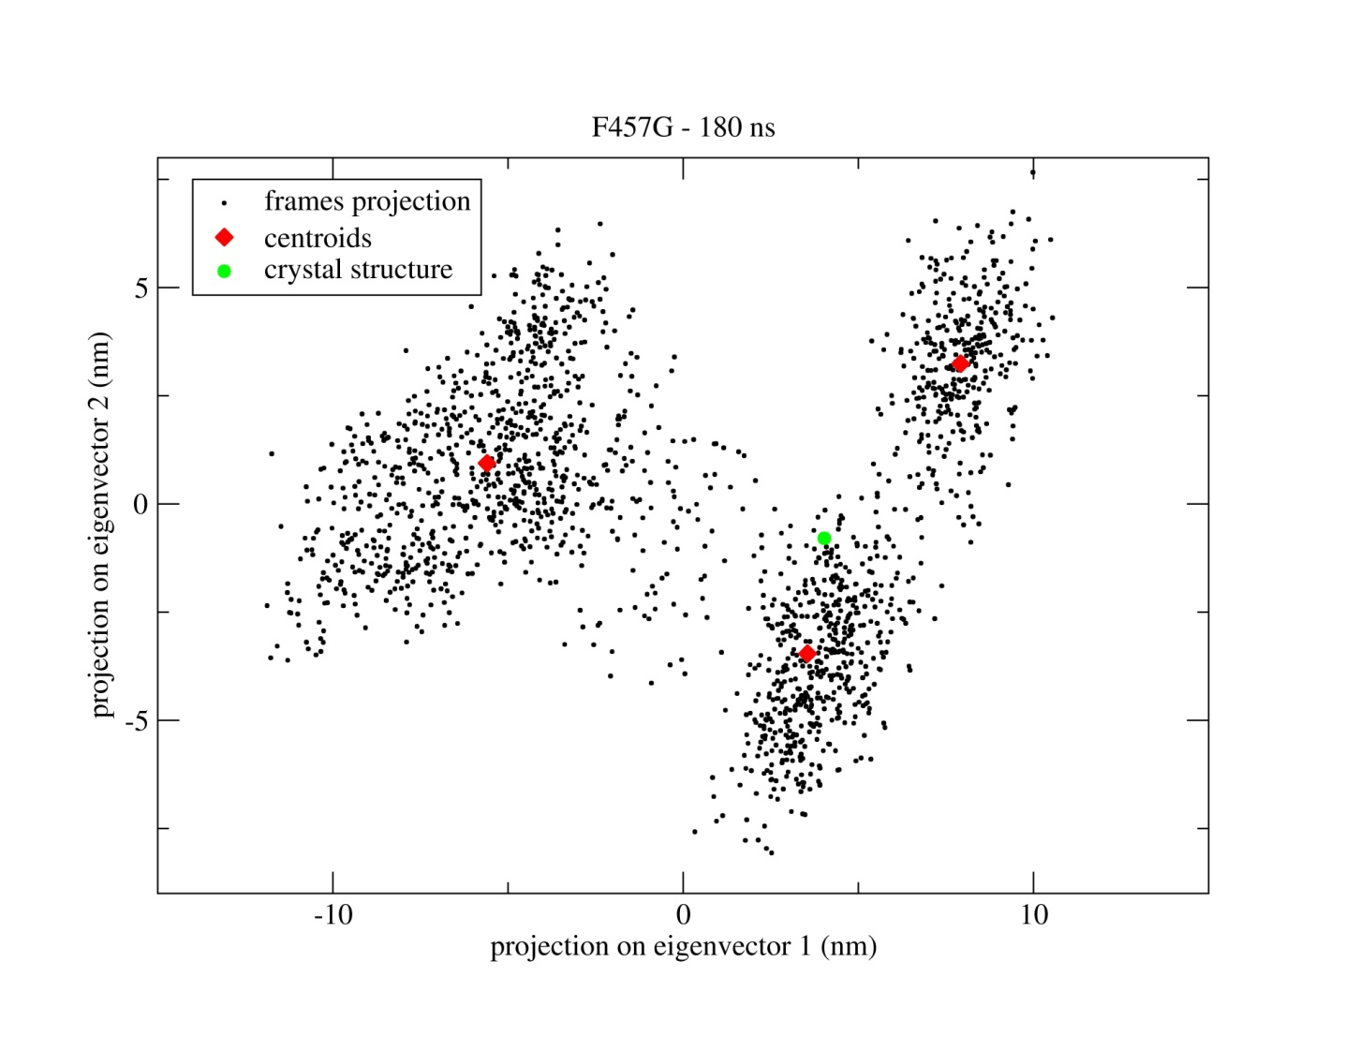
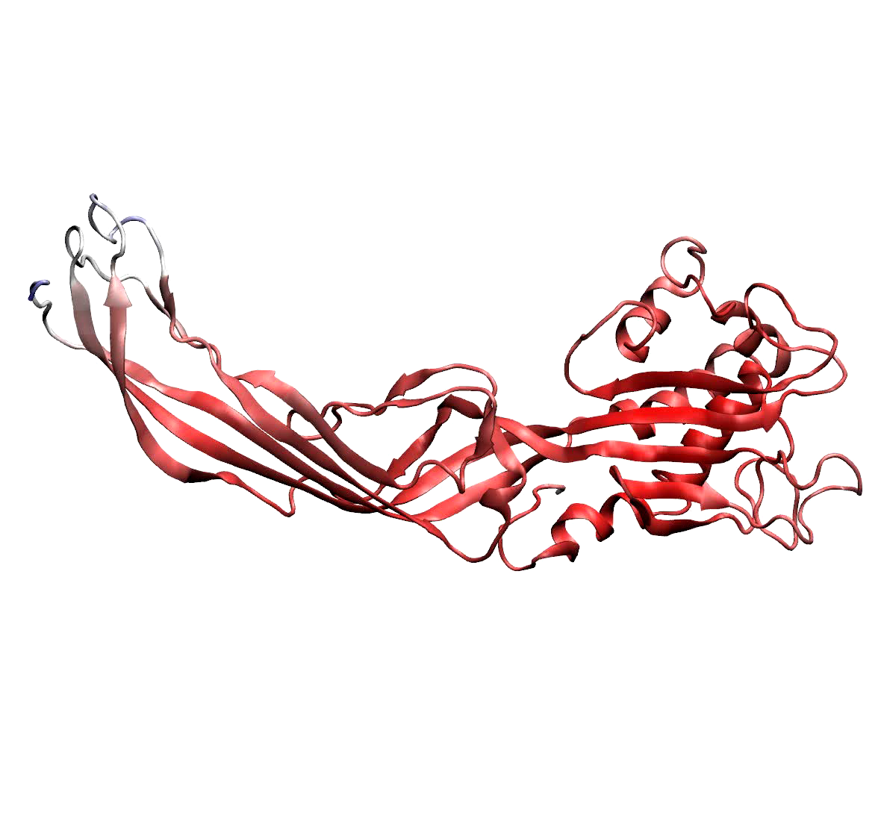
[Example 2] Identifying dominant motions in proteins
Protein MD simulation
Project MD in eigenspace
Simulations are complex and noisy
select only first few PC (eigenvectors) to separate signal from noise
14
Degiacomi, M.T. & Dal Peraro, M.. Macromolecular symmetric assembly prediction using swarm intelligence dynamic modeling. Structure, 2013

Slide 15
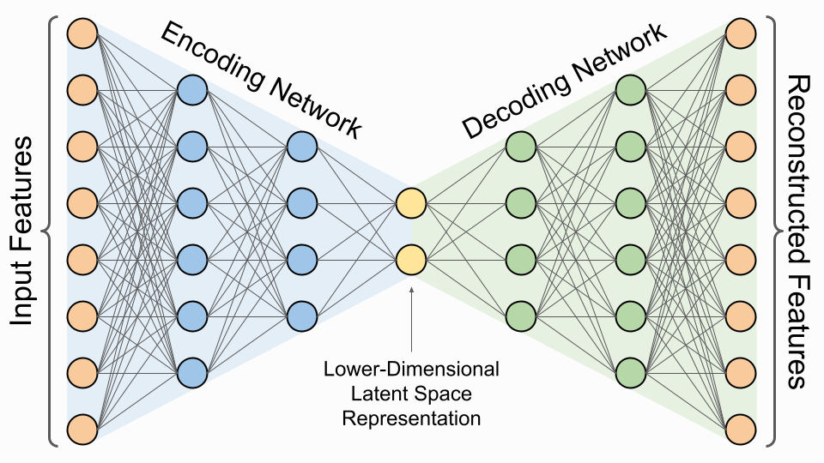
[Extra] Dimensionality reduction with neural networks
PCA dimensionality reduction is interpretable, that of t-SNE and neural networks is not.
15

Slide 16
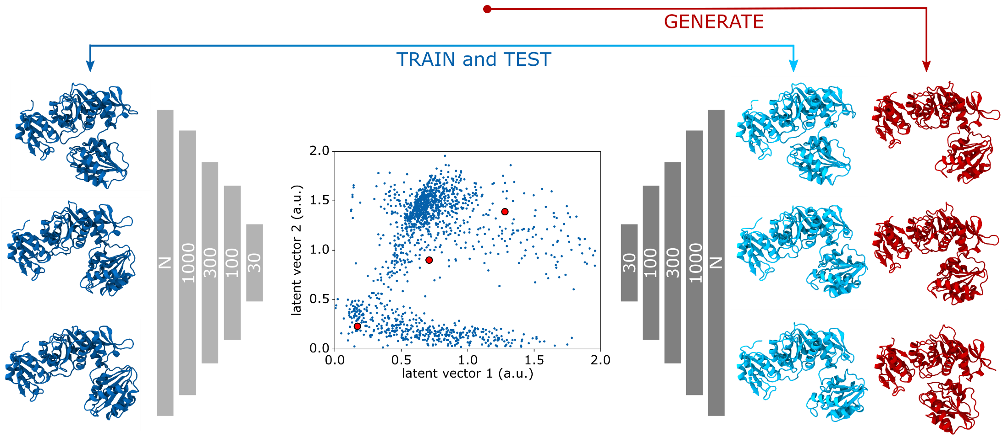
[Extra] Learning Protein Conformational Space
encoder
latent space
decoder
M.T. Degiacomi, Structure, 2019
16

Slide 17
Time-lagged independent component analysis (tICA)
tICA is a linear transform similar to PCA
The transform is chosen such that, amongst all linear transforms, tICA maximizes the autocorrelation of transformed coordinates.
Thought experiment: typically hydrogen bond is considered established if donor-acceptor distance <2.5 Å, and donor-acceptor-hydrogen angle <20°.
bond
formed
50%
bond not
formed
50%
time
time
reporting % time a bond is established in simulation can be misleading!

Slide 18
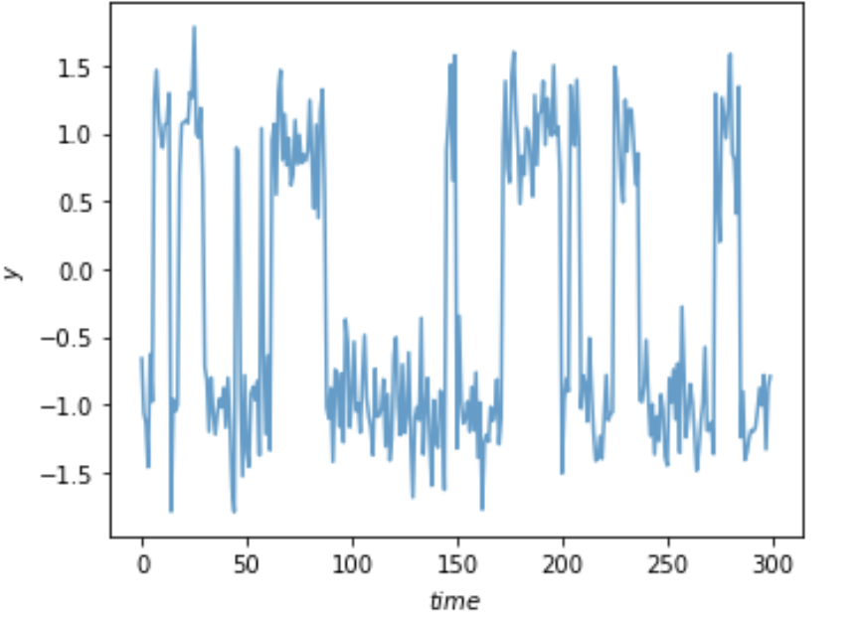
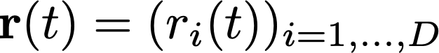
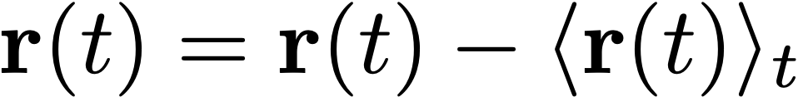
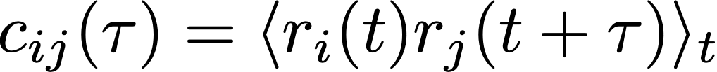
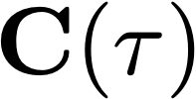
Time-lagged independent component analysis (tICA)
tICA is a linear transform similar to PCA
The transform is chosen such that, amongst all linear transforms, tICA maximizes the autocorrelation of transformed coordinates.
D-dimensional input data vector that is mean free, i.e.,
Computing the covariance of the data at
t = 0 and t = τ which is the lag-time chosen
enables computing two covariance matrices:
and
F. Nüske, […], A. S. J. S. Mey and F. Noé: JCTC, 2014
18
G. Perez-Hernandez, et al., JCTC, 2013
C. R. Schwantes et al., JCTC, 2013

Slide 19
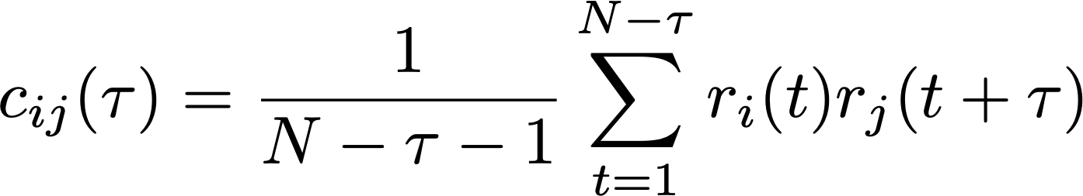
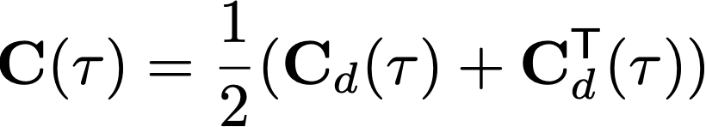

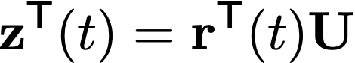
Time-lagged independent component analysis (tICA)
tICA is a linear transform similar to PCA
The transform is chosen such that, amongst all linear transforms, tICA maximizes the autocorrelation of transformed coordinates.
Entries of the covariance matrix can be computed as:
will be a symmetric matrix.
The symmetry of will need to be enforced with:
We can now solve the generalised eigenvalue problem:
Eigenvector matrix containing ICs
Diagonal matrix with eigenvalues
M columns of full rank U for DR
F. Nüske, […], A. S. J. S. Mey and F. Noé: JCTC, 2014
19
G. Perez-Hernandez, et al., JCTC, 2013
C. R. Schwantes et al., JCTC, 2013

Slide 20
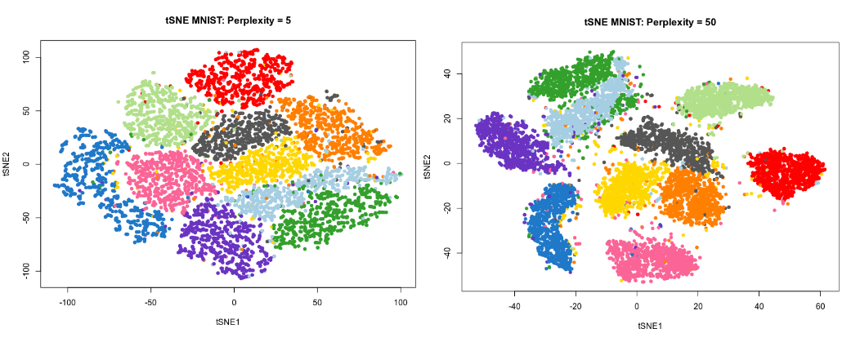
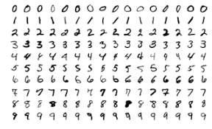
t-distributed stochastic neighbour embedding (t-SNE)
Useful for visualisation, project high-dimensional data in 2 or 3 dimensions.
Controlled by one main parameters: “perplexity”
Relative distance between points not quantitatively meaningful
MNIST: database of written digits
20

Slide 21
The Data Mining world
From scikit-learn.org
21

Slide 22
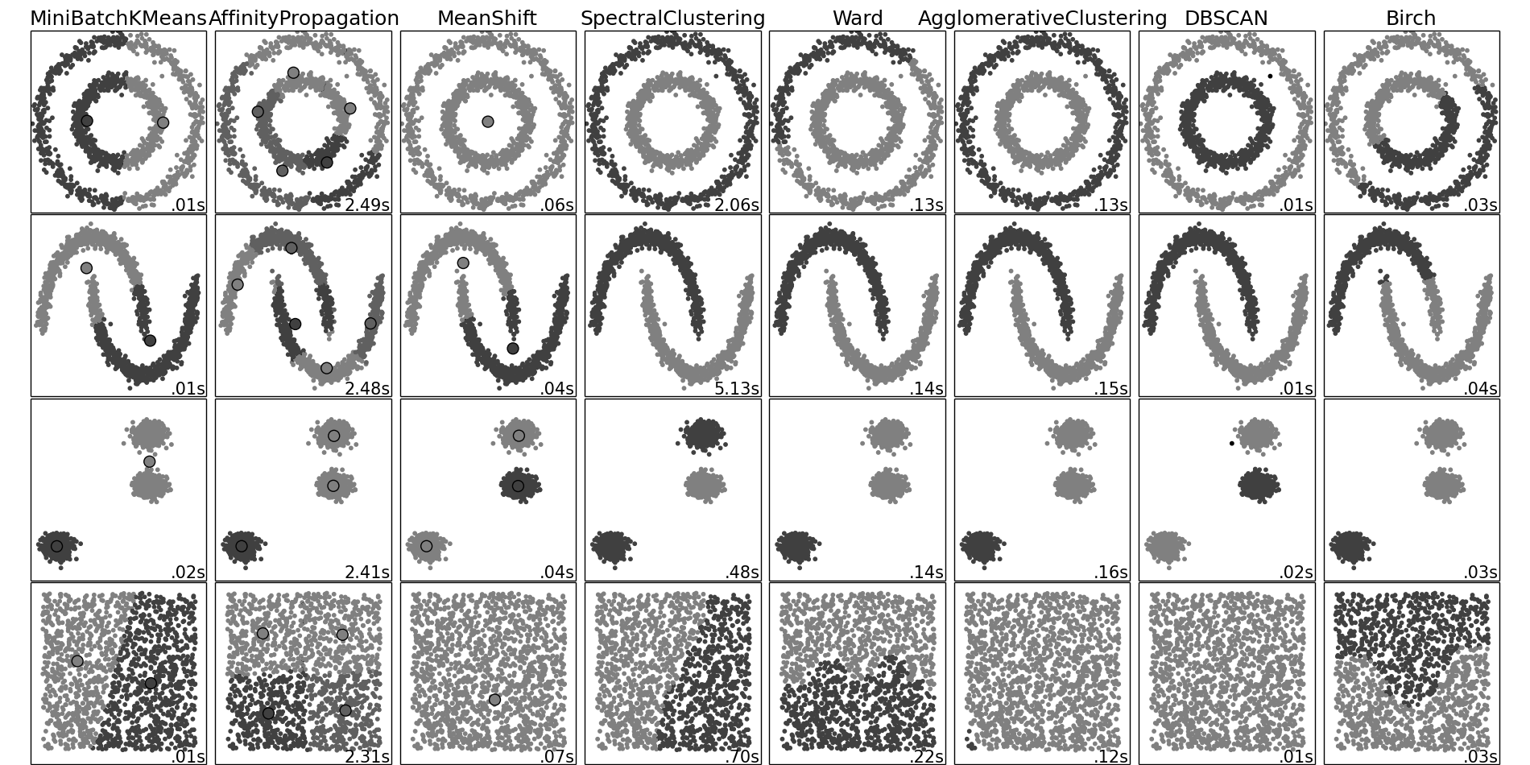
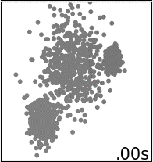
Clustering (i.e., unsupervised learning)
Known number of clusters? Flat geometry?
Even cluster size? Outliers? Centroids needed?
22

Slide 23
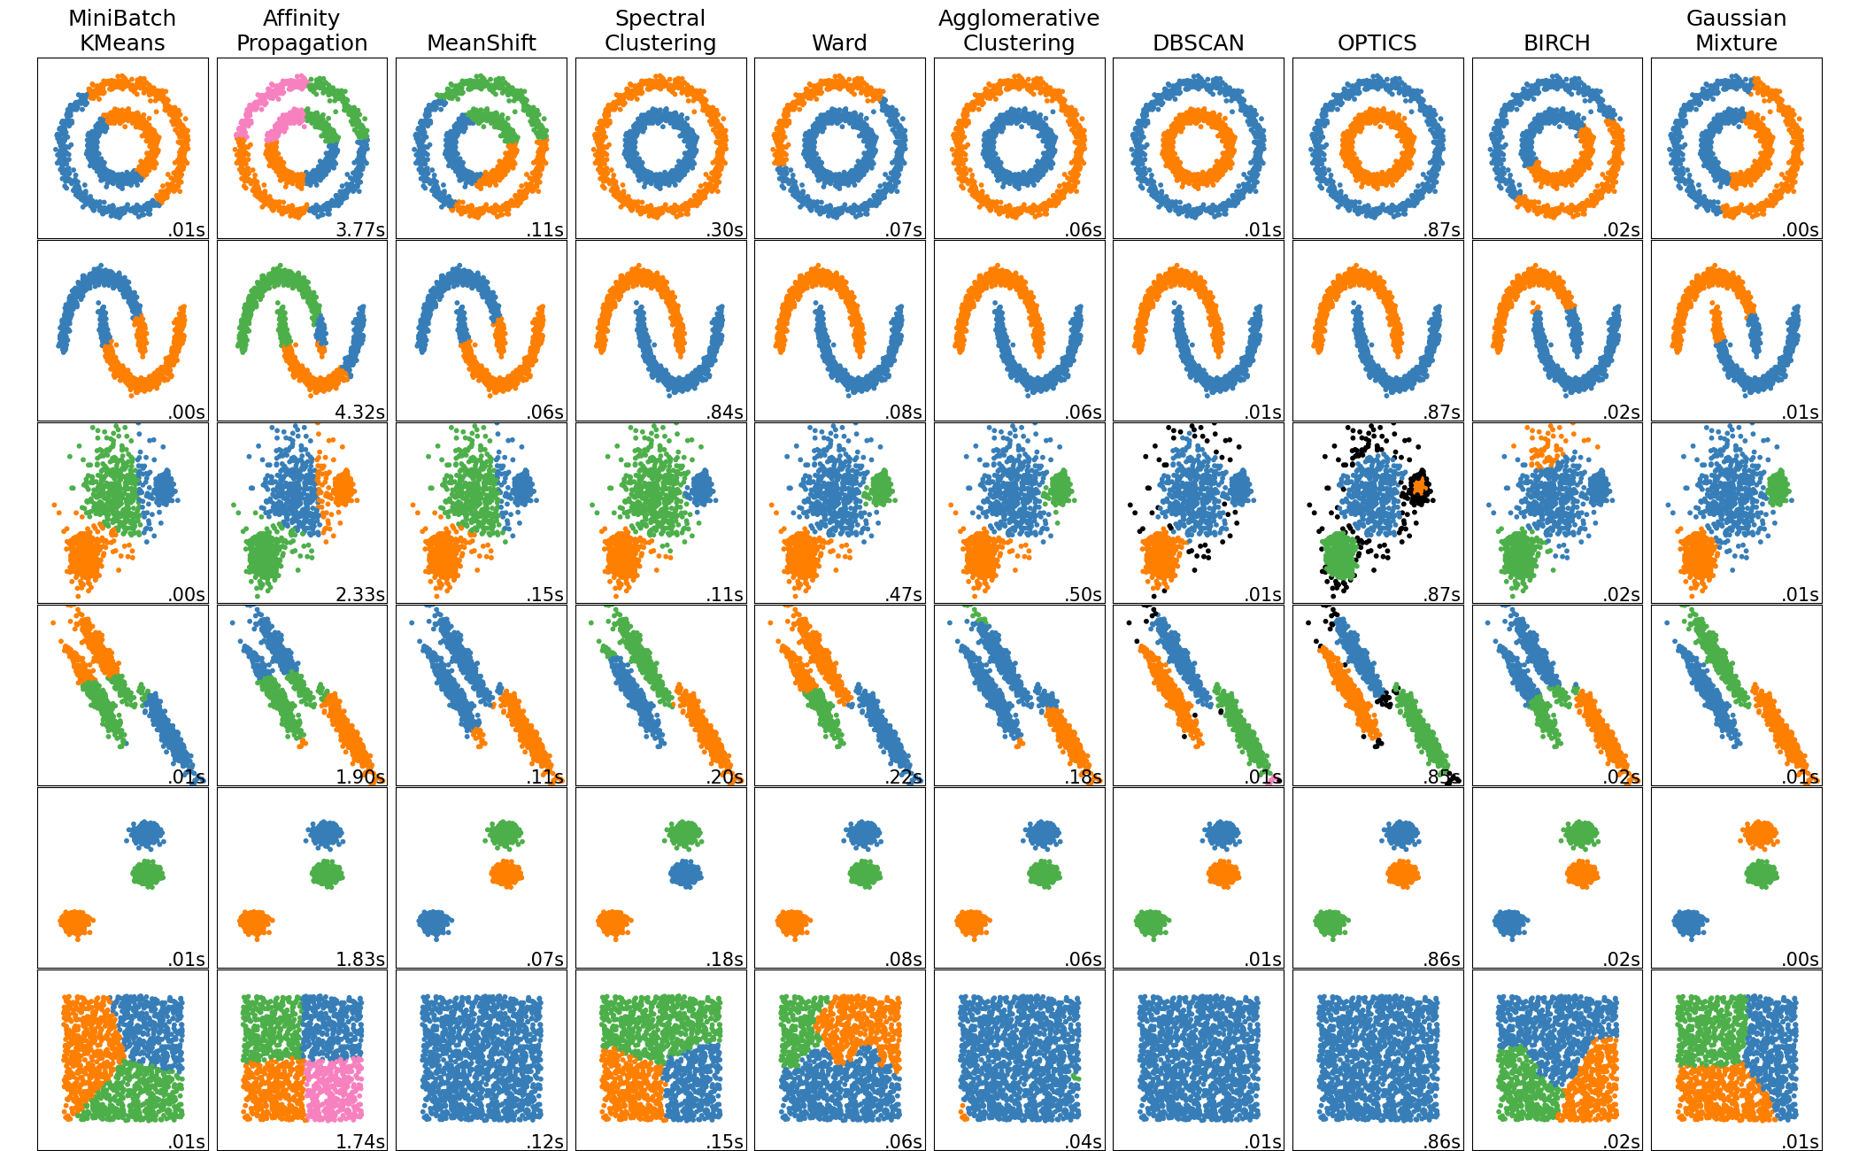
Clustering algorithms
scikit-learn.org/stable/modules/clustering.html
23

Slide 24
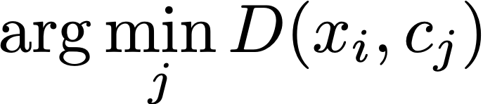
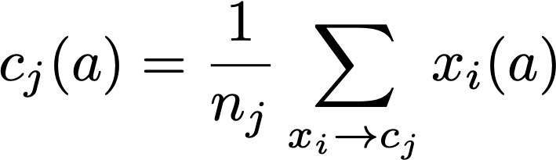
How does k-means work?
Input: K, set of points x1…xn (can be in N-dimensional)
Place centroids, c1…,cn at random locations
Repeat until convergence:
For each point xi:
Find nearest centroid cj =
Assign the point xi to cluster j
For each cluster j = 1…K:
Compute the centroid mean for all points in
one cluster and update the centroid
24

Slide 25

How does k-means work?
Input: K, set of points x1…xn (can be in N-dimensional)
Place centroids, c1…,cn at random locations
Repeat until convergence:
For each point xi:
Find nearest centroid cj =
Assign the point xi to cluster j
For each cluster j = 1…K:
Compute the centroid mean for all points in
one cluster and update the centroid
25

Slide 26
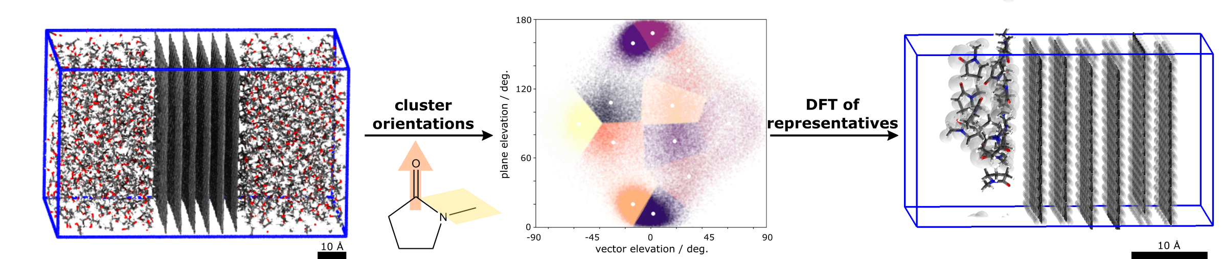
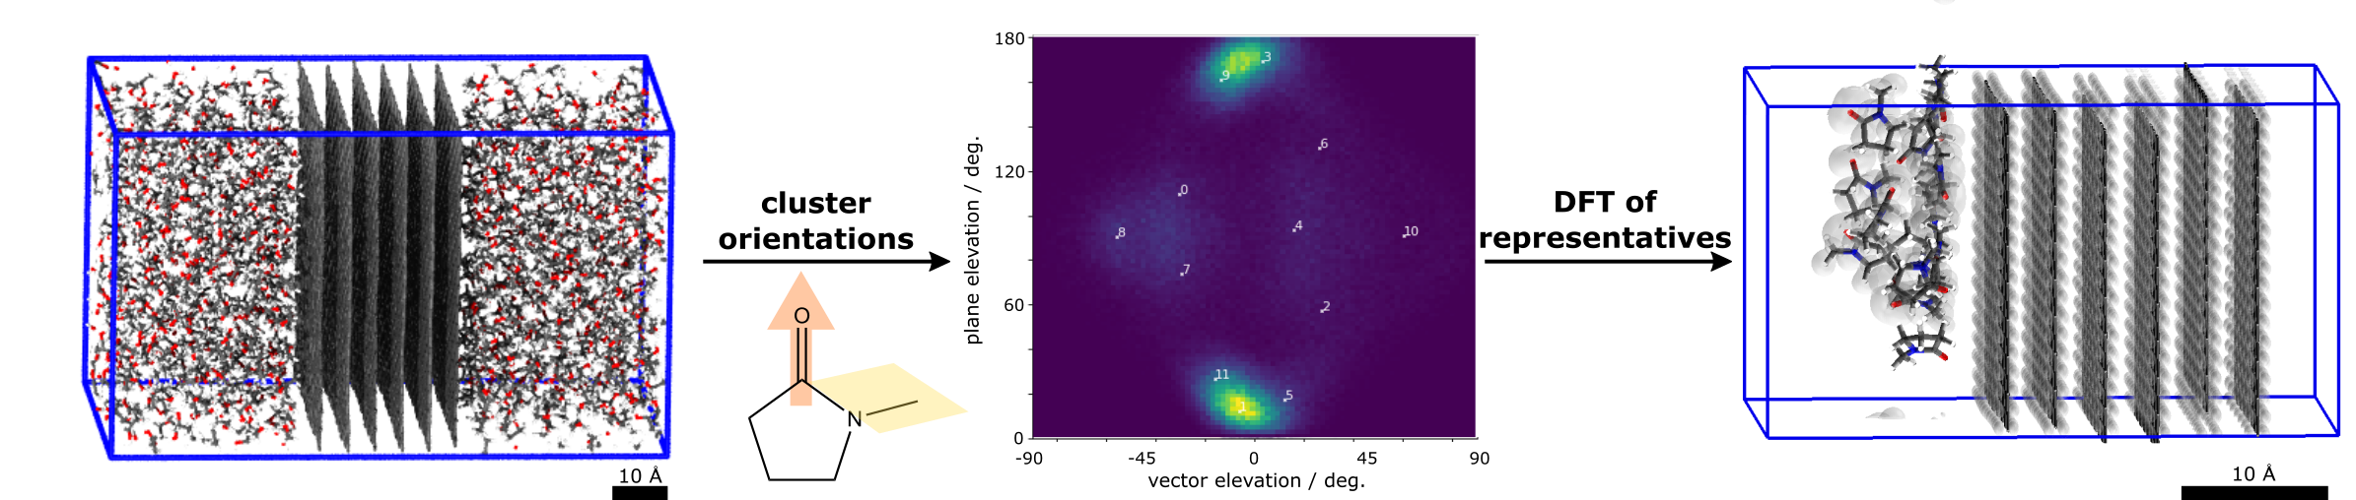
[Example] k-means vs solvent-graphite interactions
Molecular Dynamics simulation of graphite immersed in solvents.
>100k individual solvent-graphene interactions
26
S. J. Goldie, M. T. Degiacomi, et al. Identification of Graphene Dispersion Agents through Molecular Fingerprints. ACS Nano, 2022

Slide 27
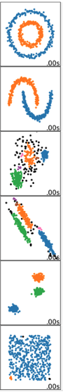
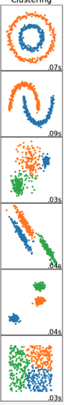
Density-based and spectral clustering
DBSCAN
Spectral Clustering
27

Slide 28
Density-based and spectral clustering
Spectral
Clustering
DBSCAN
Find the points in the ε neighbourhood of every point, identify core points with more than n neighbours.
Find the connected components of core points on the neighbour graph, ignoring all non-core points.
Assign each non-core point to a nearby cluster if the cluster is an ε neighbour, otherwise assign to noise otherwise.
Calculate the Laplacian
Calculate the first k eigenvectors
Consider the matrix formed by the first k-eigenvectors
Cluster the graph nodes based on these features (e.g. k-means)
28

Slide 29
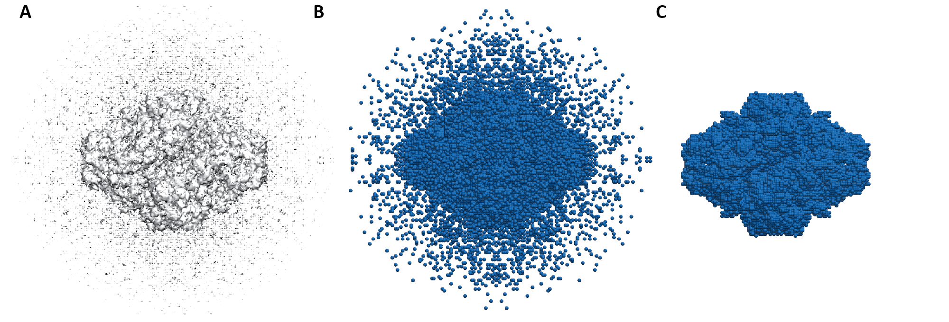
[Example] DBSCAN for noise detection in EM maps
Load electron density map and chose a threshold t
Place pseudoatoms where intensity > t
Cluster beads and delete small clusters (<1% of total beads)
M.T.Degiacomi and J.L.P. Benesch, EM∩IM: software for relating ion mobility mass spectrometry and electron microscopy data, Analyst, 2015
29

Slide 30



Post-its
Something you think could be improved
Something you liked
Something you liked
😎👍
😬👎

